Slide 1
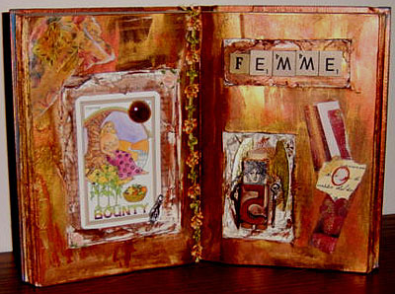
Altered Books

Slide 2
What is a book?
Is it an art form?
Can books be artistic?

Slide 3
YES!

Slide 4
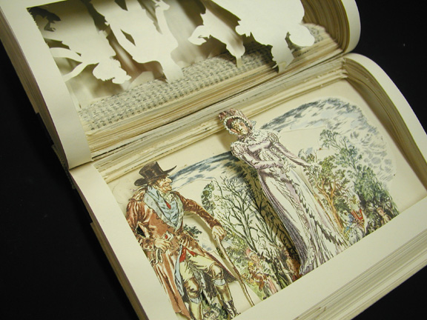

Slide 5
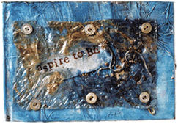
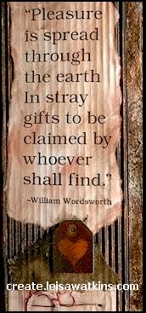

Slide 6
Altered Book Videos
http://www.youtube.com/watch?v=ZWG6P88US0c

Slide 7
Create a Cover
You are going to redesign the cover to illustrate
YOU!

Slide 9
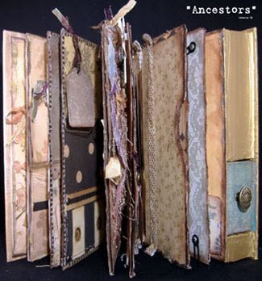
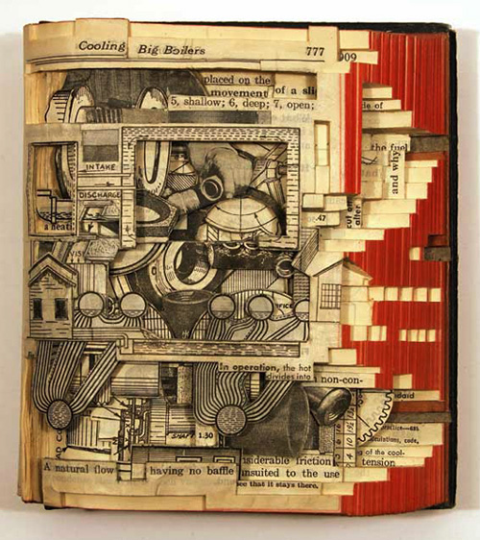
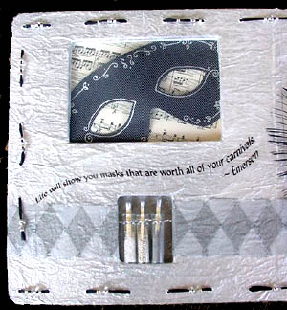
Altered Book Artists
Rebecca Sawyer
Brian Dettmer
Karen Hatzigeorgiou

Slide 10
You are going to….
Cover two or more pages with rubbings and textured items
Divide two pages into 4 sections and fill each space using different marks and lines
Create a pattern and fill a page with it, almost like wallpaper
Fill two pages with objects of a color of your choosing.

Slide 11
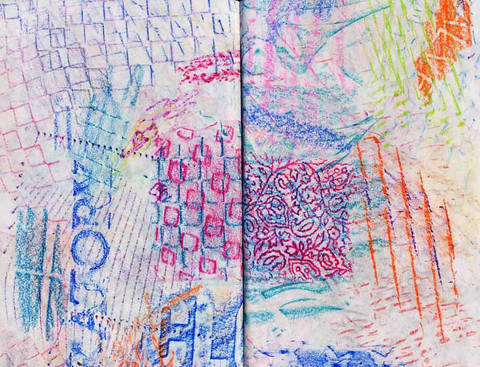
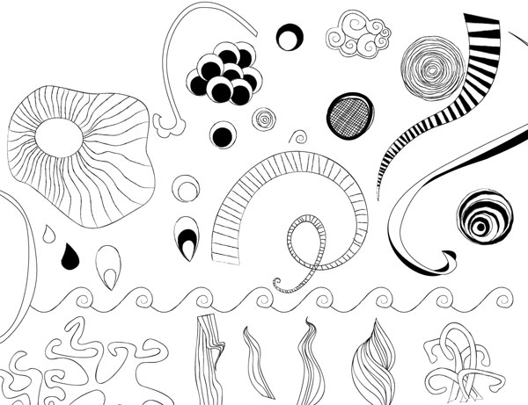
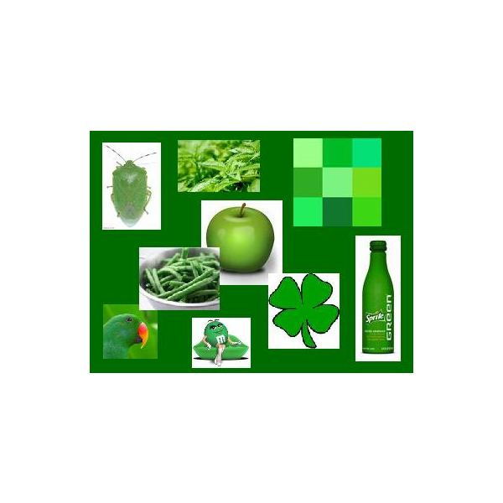
Texture Rubbings
Boxes of Line
Color Collage

Slide 12
Choose Two….
Change the shape two or more pages
Fill two pages with a drawing of your favorite dinner
Make a design out of yarn
Glue a piece of photograph onto a page and complete the image with pencil or marker.
Write a message in cursive.
Illustrate a poem
Cut shaped windows out of a page
Fill two pages with a collage of paper and other materials
Draw on an image that is already in your book

Slide 14
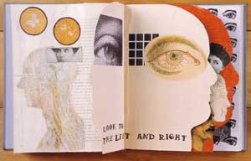
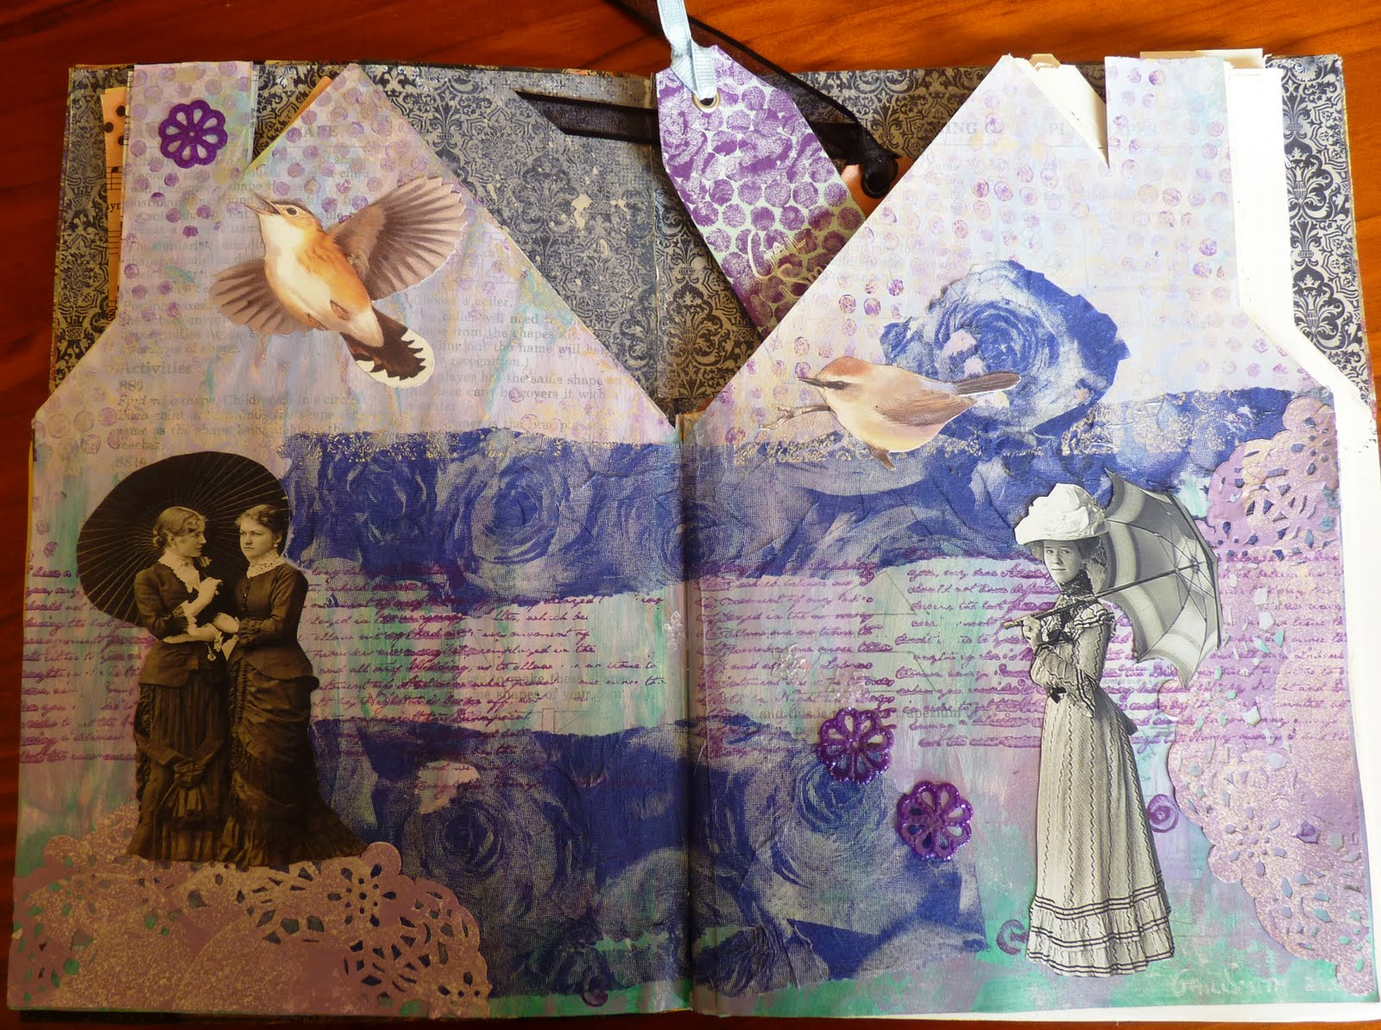

Slide 16
