Slide 1
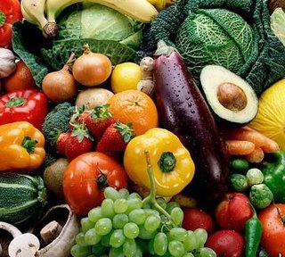
FRUITS AND VEGETABLES!

Slide 2
What types of fruits are there?

Slide 3
What types of vegetables are there?

Slide 4
Which ones are your favorites?

Slide 5
Where do they grow?

Slide 6
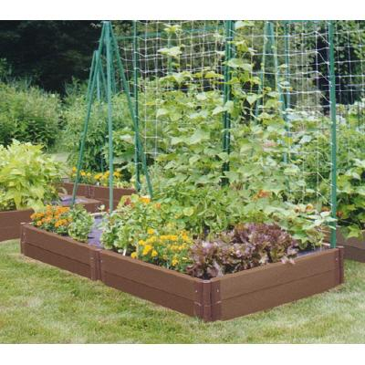
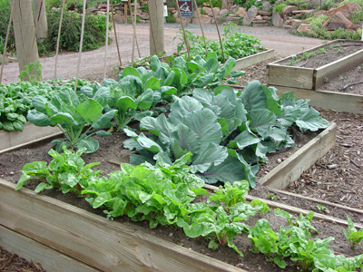
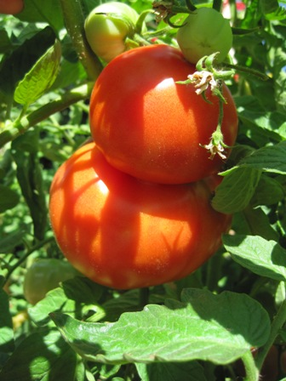
GARDENS!

Slide 7
What we are going to do…

Slide 8
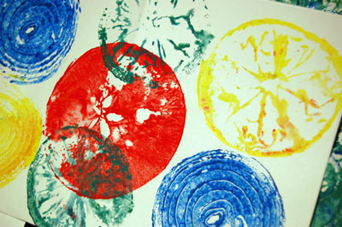
Fruit and Vegetable Prints

